Slide 1
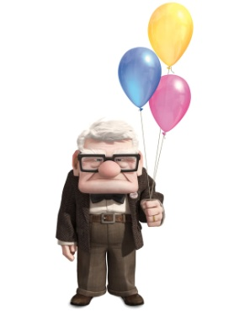
Synonyms

Slide 2
SYNONYMS
LO - To use synonyms in the correct context.

Slide 3
What is a synonym?
A synonym is a word that has a similar meaning to another.
Example.
good
fine
okay
Similar means almost the same but with a small difference.
Can you describe the difference between the words?

Slide 4
Can you match up the synonym pairs?
huge
soggy
hot
big
wet
ill
sick
warm

Slide 5
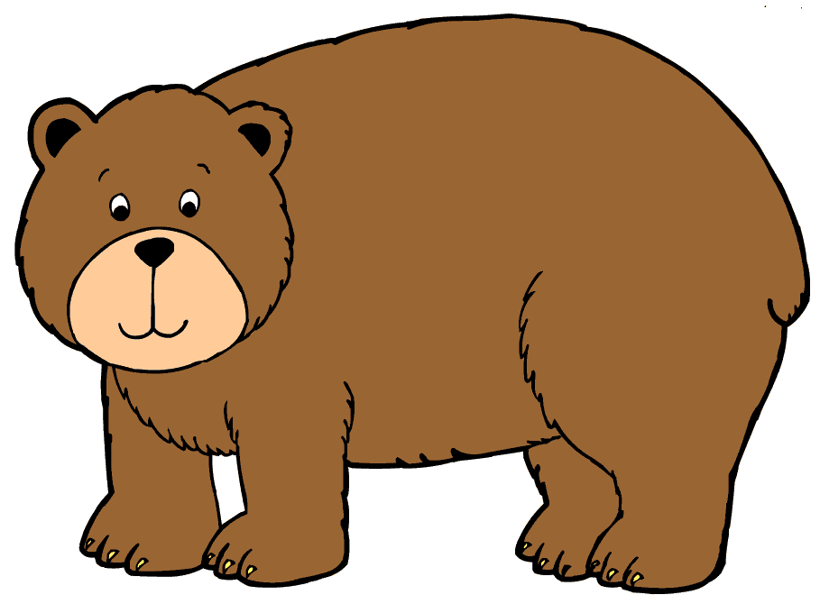
The POWER of words!
Most synonyms can be ordered by how powerful they are, e.g.
big huge colossal

Slide 6
Shades of meaning
Start with a feelings word.
Brainstorm synonyms for your feelings word.
Write the synonyms onto the word wall in order of strength.

Slide 7
How can we use synonyms?
Synonyms can be used instead of common words (high frequency words.)
Common words lack power in our writing. They can make our writing boring.
By choosing more unusual words a text can become interesting.

Slide 8
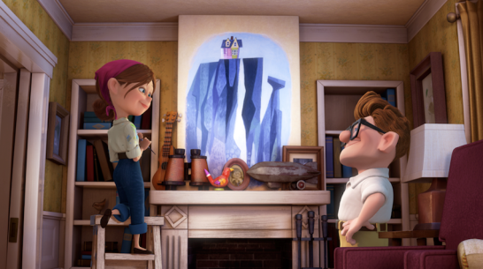
Carl and Ellie
From the moment Carl met Ellie she made him feel happy.
When they bought their first home together Carl and Ellie were very happy.
Some of the couples happiest times were afternoon picnics under the shade of the old Oak tree.
As Carl finally bought two plane tickets to follow their dream he felt happy.

Slide 9
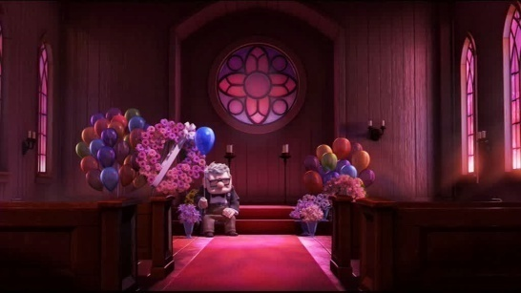
Carl and Ellie
Ellie and Carl were so sad when they found out from the doctor that they could not have children.
Every time the couple needed to break open the savings jar to pay another bill they felt sad.
As Carl noticed Ellie’s pale face in a hospital bed he felt so sad.
Finally as Carl sat on the step of his home and realised that Ellie was gone, he felt a great sadness.

Slide 10
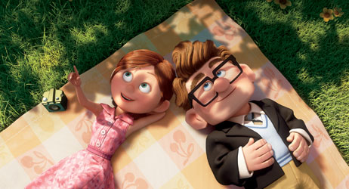
Task
Can you use the synonyms from your word walls and some figurative language, to describe how Carl felt at different times in the film clip. Do not use the words SAD or HAPPY as they are boring!! Choose your words for effect like an author.

